Slide 1

Communication
Dr. Koninika mUKHERJEE

Slide 2
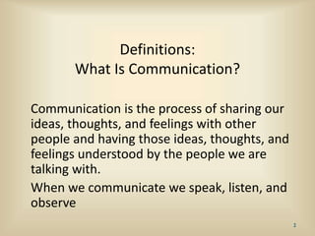

Slide 3
Characteristics
Dynamic process
Uses a channel
For a communication to be effective it has to achieve the desired consequences as intended by the communicator.

Slide 4
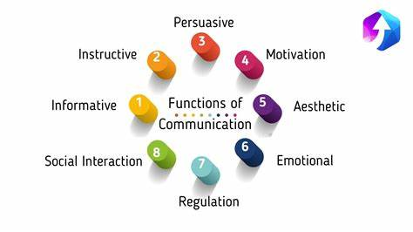

Slide 5
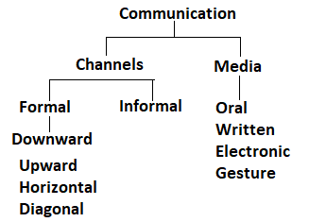

Slide 6
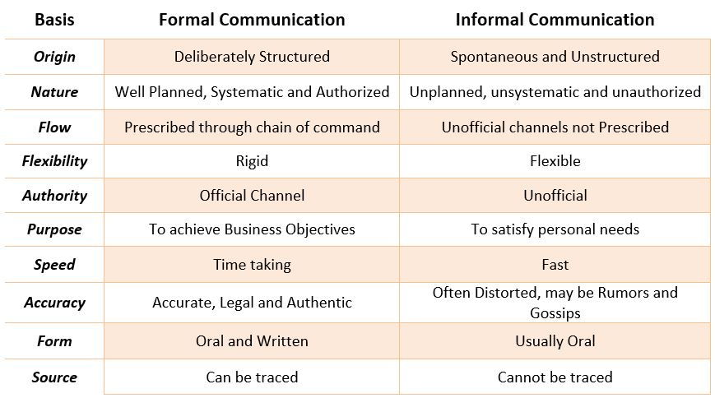

Slide 7
Vertical communication
Orders and instructions issued by managers to subordinate and performance reports sent by subordinates to the managers are typical examples of vertical communication. It may be sub-divided into:
Downward Communication : Communication which flows from higher-level managers to others in lower-level positions is generally known as downward communication. It also includes directives and messages which are issued by top management and are transmitted down the hierarchy through intermediate levels of management to employees at the lower levels. Such communications may consist of verbal messages conveying orders, policies, procedures, or written matter conveyed through notices, circulars, memoranda, bulletins, handbooks etc.
Upward Communication : This type of communication flows from lower level managers and employees to those in higher level positions. The upward channels of communication not only enable higher level managers to get valuable information but also opinions and suggestions from lower levels at the time of making decisions on plans and policies. The opportunity of upward communication encourages people to transmit their complaints and grievances to superiors, draw the attention of managers to problems and make proposals for improving the efficiency of work performance in the organisation. .

Slide 8
HORIZONTAL COMMUNICATION
Communication that takes place directly between two persons having equal ranks in the managerial hierarchy or between two subordinates ' under the same manager is called horizontal communication or lateral communication. Thus, horizontal communication consists of interaction between people in the same or different departments. This facilitates coordination of activities which are interdependent.
For example, coordination of production and sales activities requires continuous exchange of information between the respective managers of the two departments. The same is true of factory manager and repairs and maintenance manager.

Slide 9
DIAGONAL COMMUNICATION
This type of communication implies exchange of information between persons who are in positions at different levels of the hierarchy and also in different departments. This type of communication does not take place except under special circumstances: For example, the Cost Accountant placed in the Accounts Department may want reports from the sales representatives for the purpose of I distribution cost analysis. These reports may be sent directly to the Cost Accountant, instead of being sent to the sales manager. However, formal communications are normally expected to be routed through the manager who is in-charge of the department from which the communication is made.

Slide 10
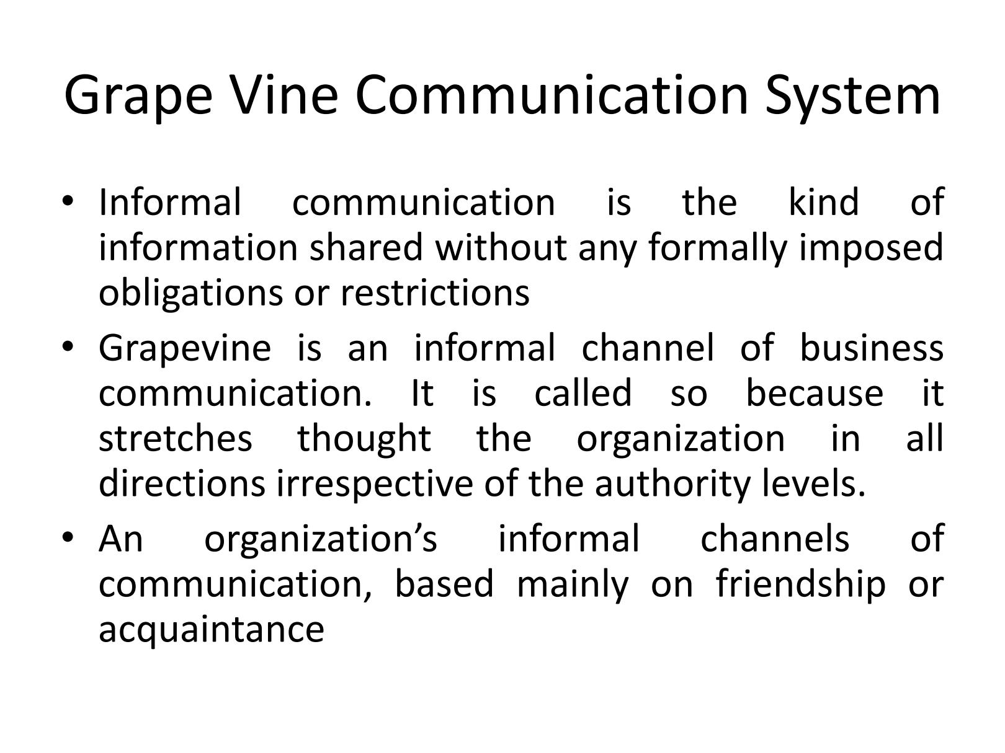

Slide 11
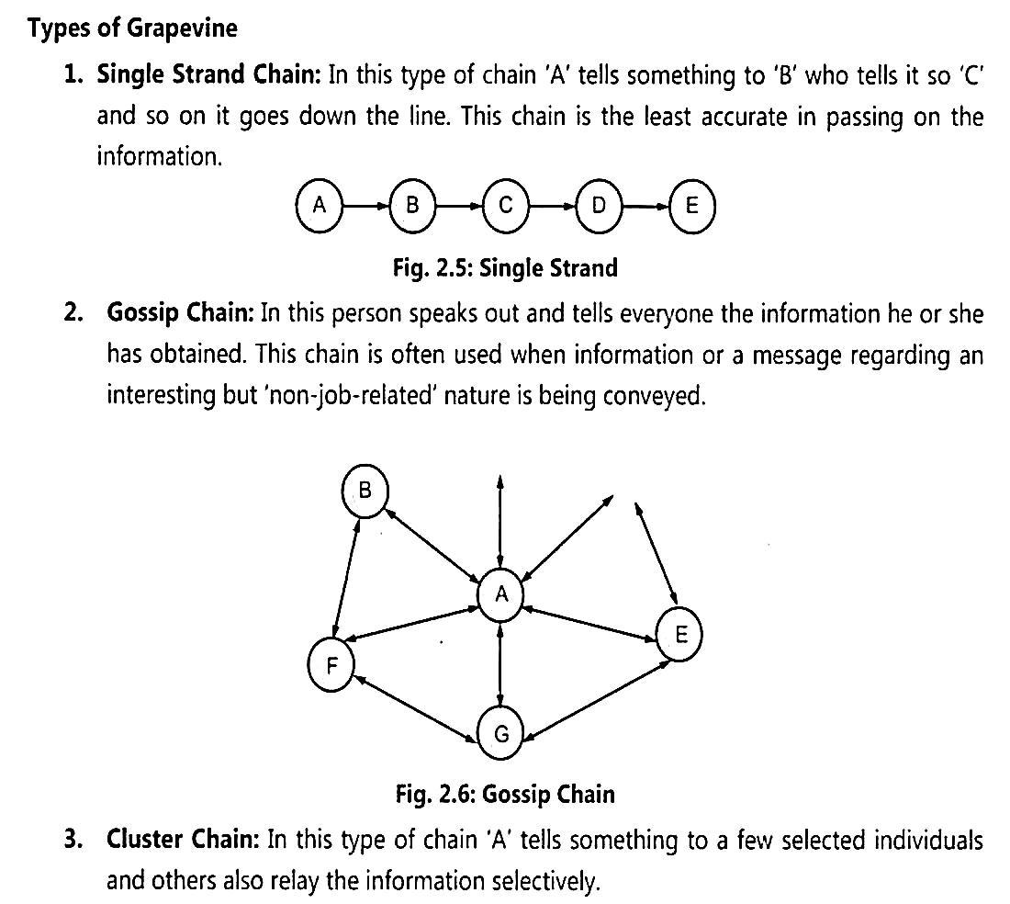

Slide 12
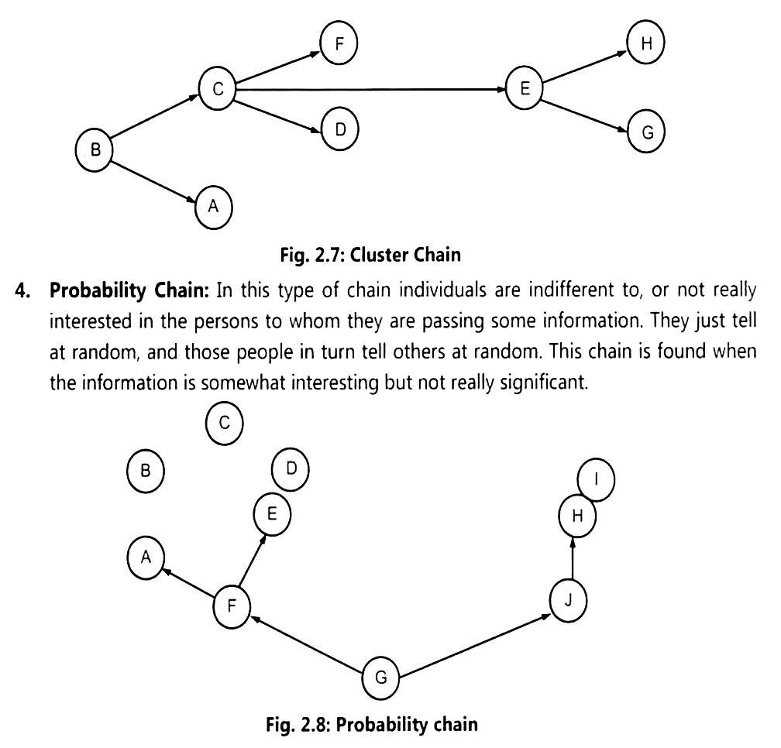

Slide 13
Models of communication

Slide 14
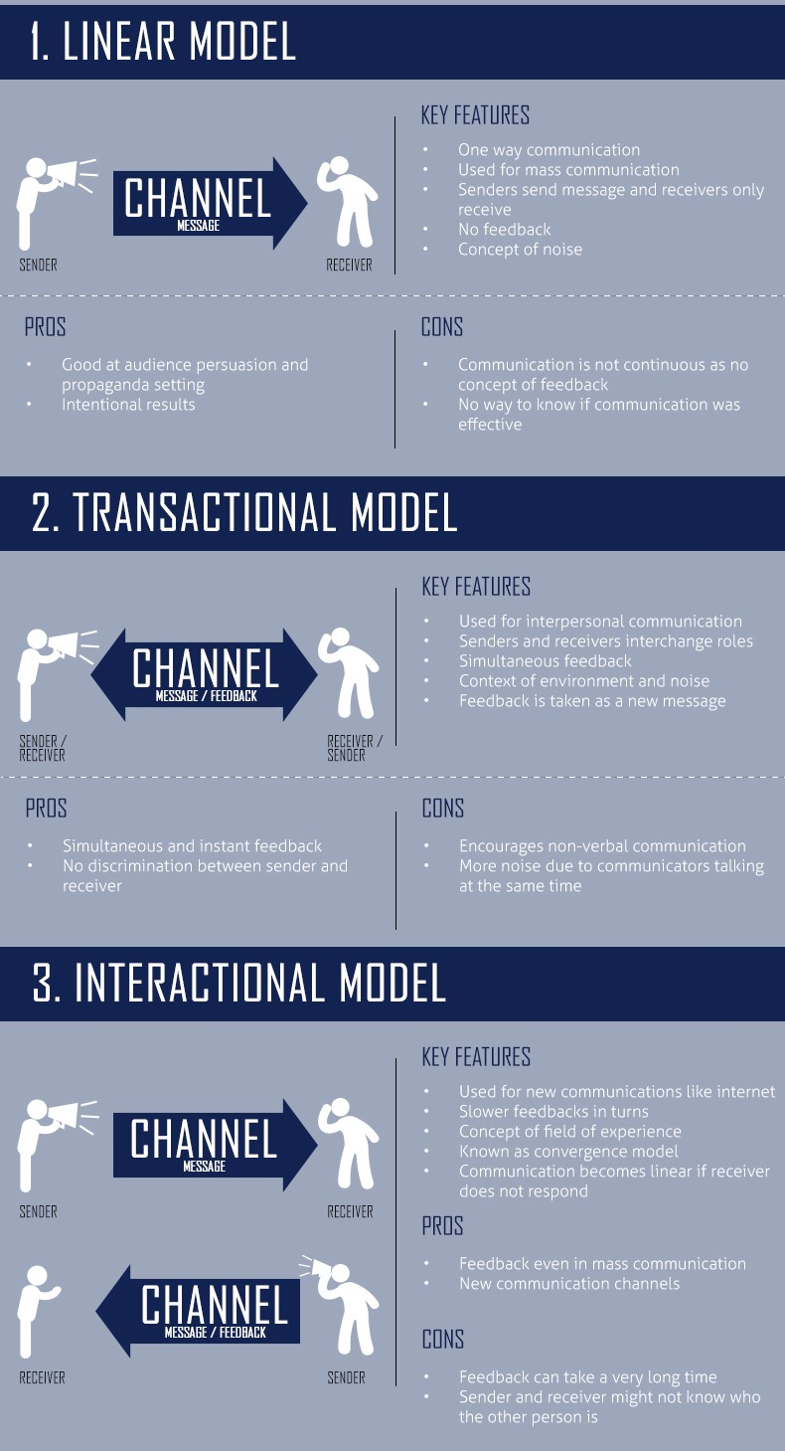

Slide 15
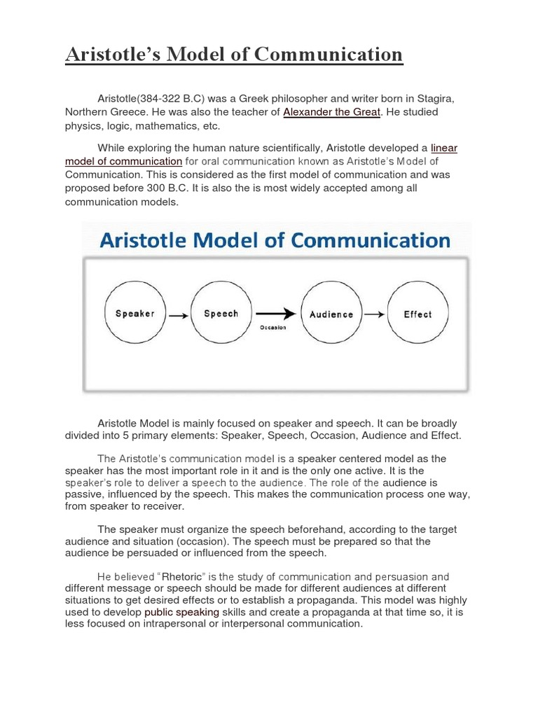

Slide 16
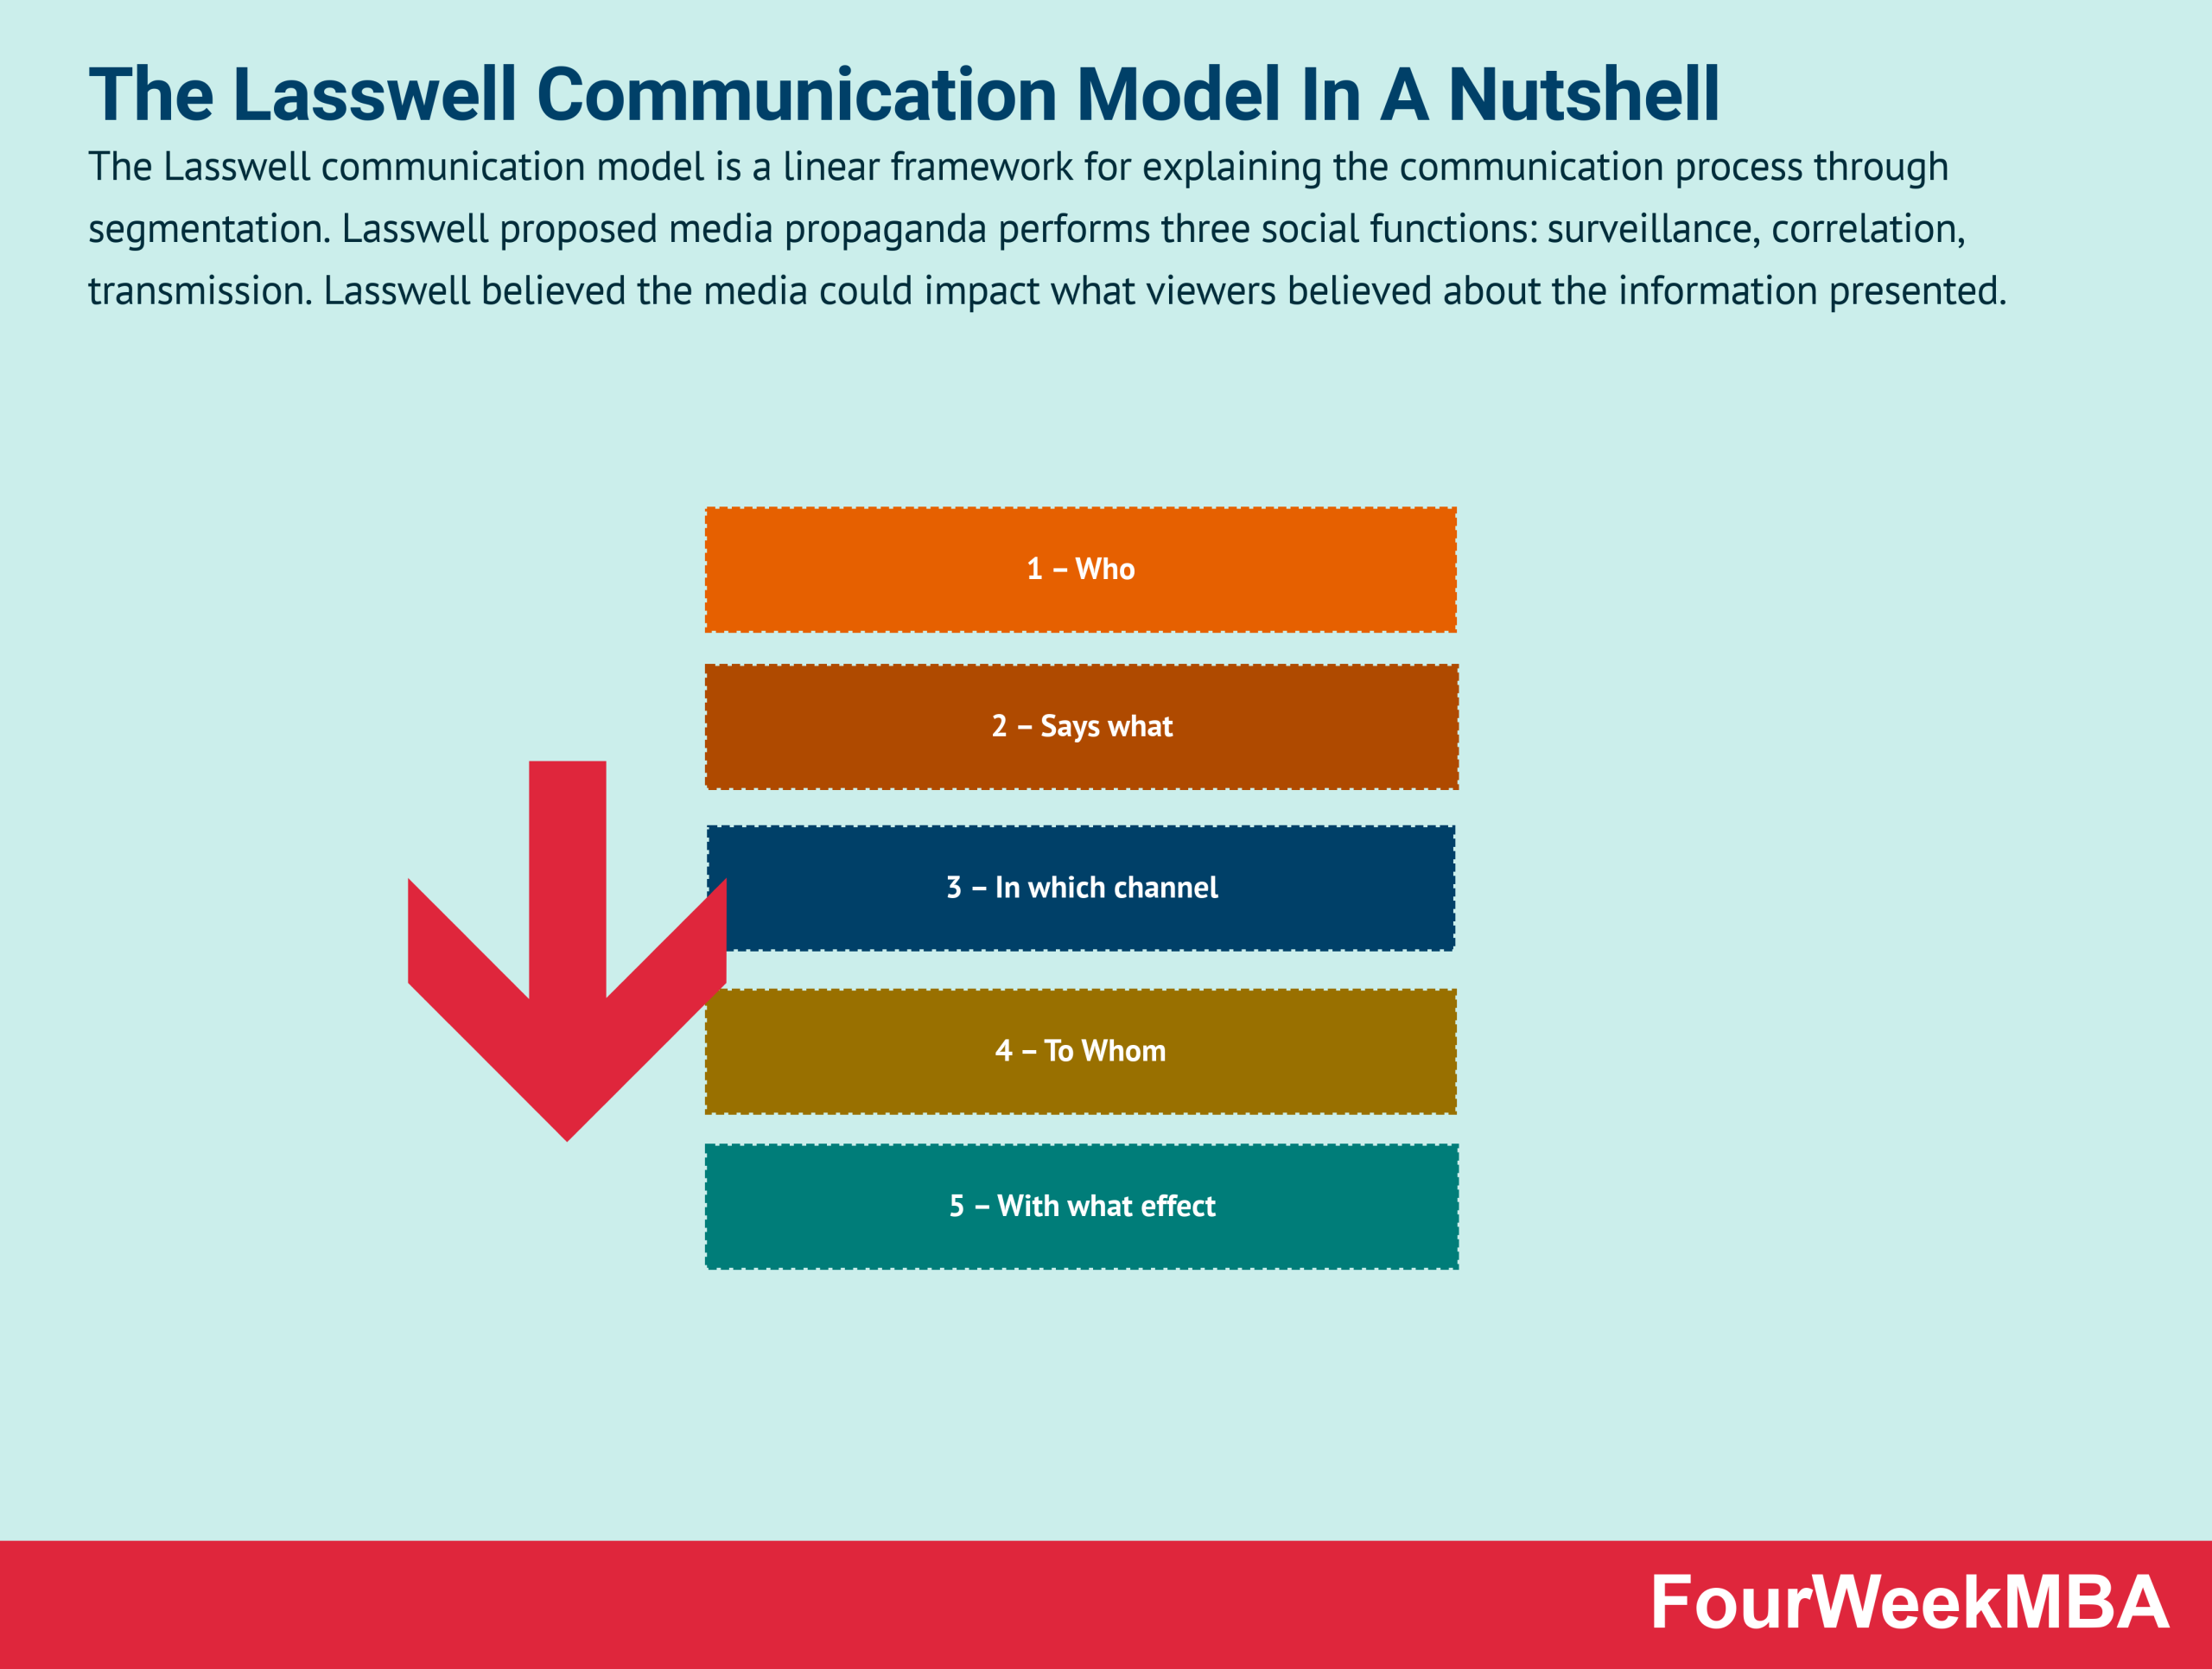

Slide 17
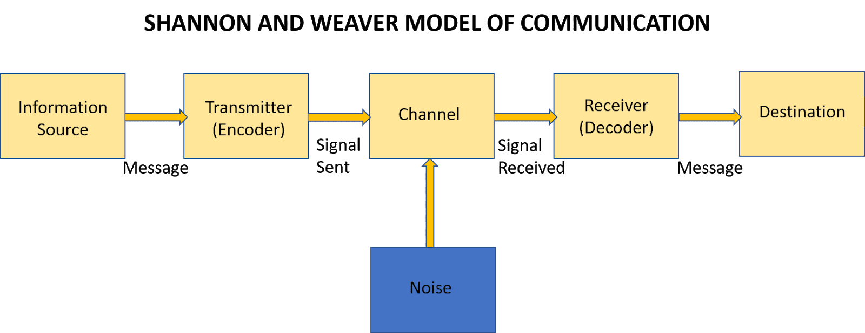

Slide 18
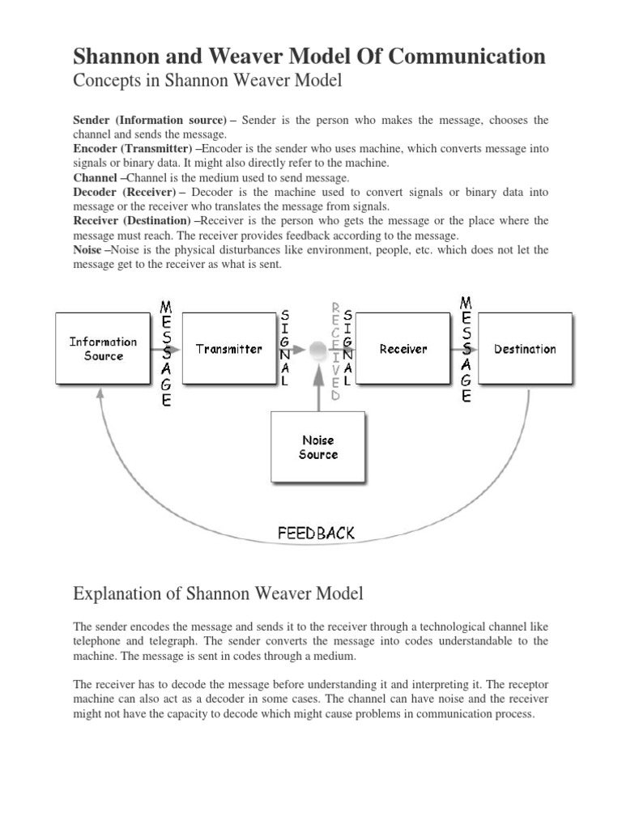

Slide 19
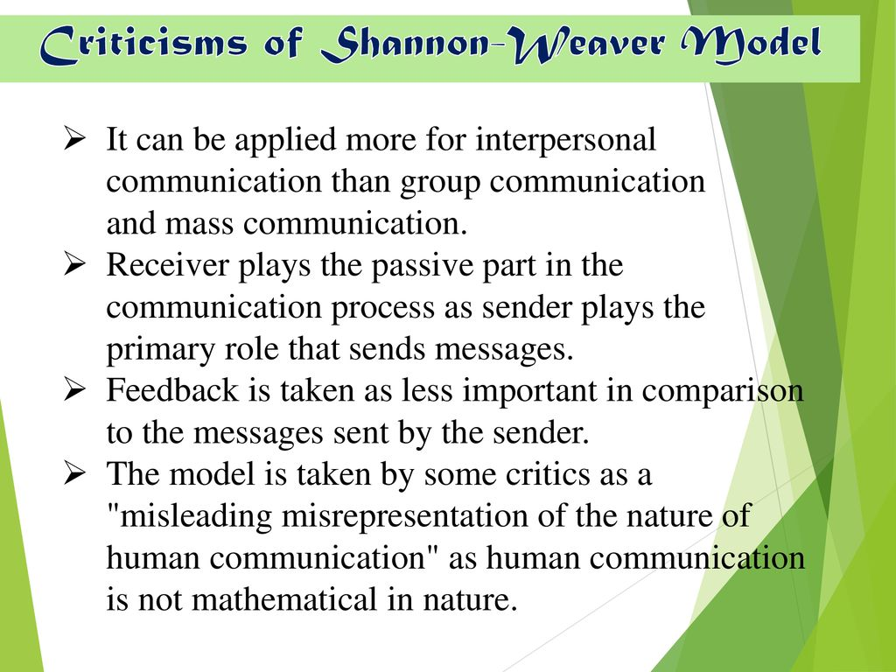

Slide 20
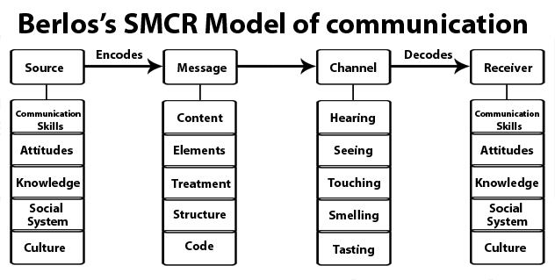

Slide 21
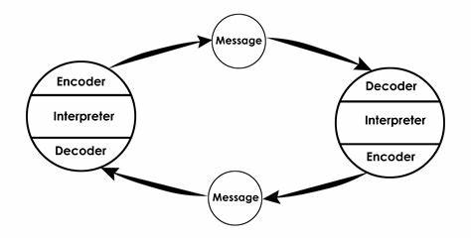
Charles osgood’s model (1954)
Osgood in his model showed communication, as a dynamic process in which there is an interactive relationship between the source and the receiver of the message (M). An individuall engaged in the communication process sends as well as receives messages and as such encodes, decodes and interprets messages through a number of feedback mechanisms. Osgood stressed the social nature of communication. This model was found more applicable in interpersonal communication in which the source and receiver were physically present.
For example when a teacher teaches, the learners interact by raising queries, answering questions, etc.

Slide 22
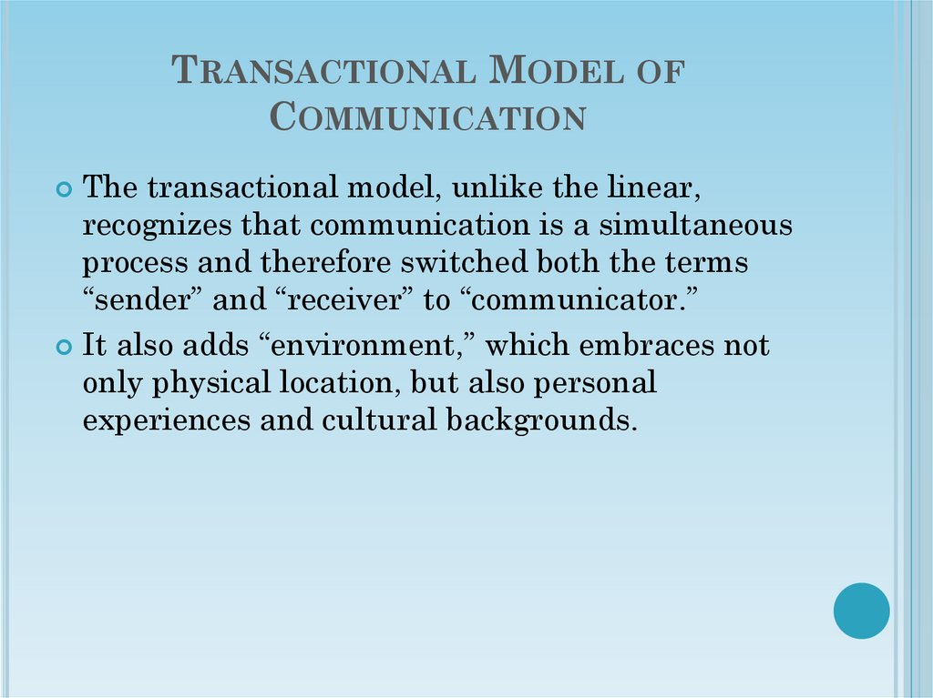

Slide 23
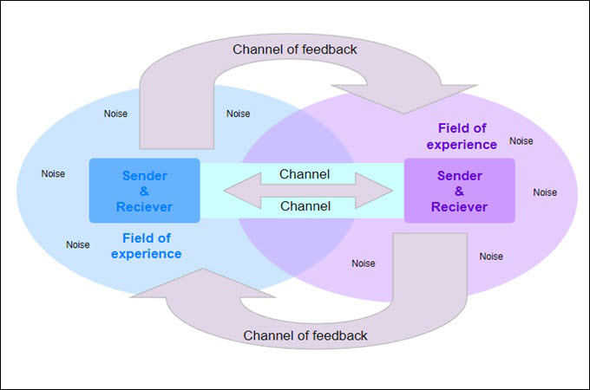
Transactional Model of communication

Slide 24
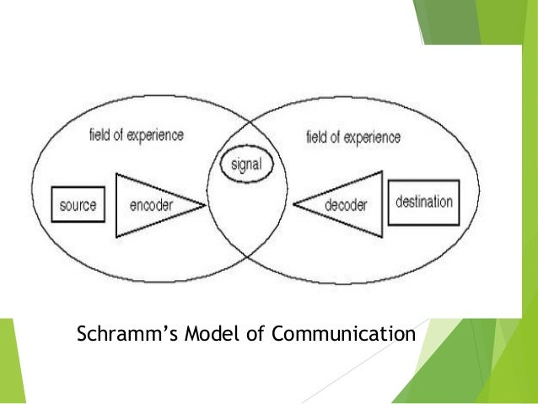
Schramm model
Schramm visualized the process of communication as a process of sharing of experience and commonality of experience of those communicating. It introduced the concept of shared orientation between sender and receiver. The circles in this model indicate the accumulated experience of two individuals engaged in communication. The source can encode and the destination can decode in terms of the experience. Communication becomes easy as both the participants have a common field of experience.

Slide 25
Schramm Model
He also included the idea of feedback by expressing that communication is reciprocal, two-way, even though the feedback may be delayed. The weakness of this model is that it is a less linear model, but it still holds good for bilateral communication. The complex, multiple levels of communication among several sources that may take place simultaneously, say in a group discussion, is nTt accounted for.

Slide 26
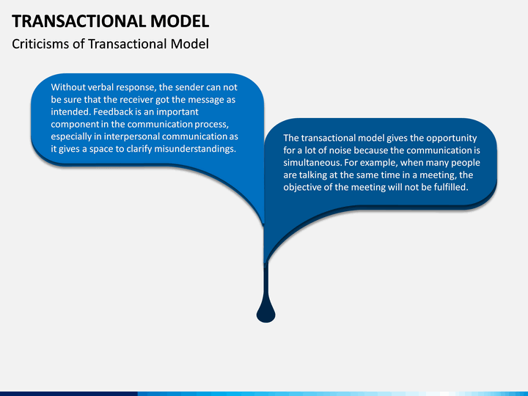

Slide 27
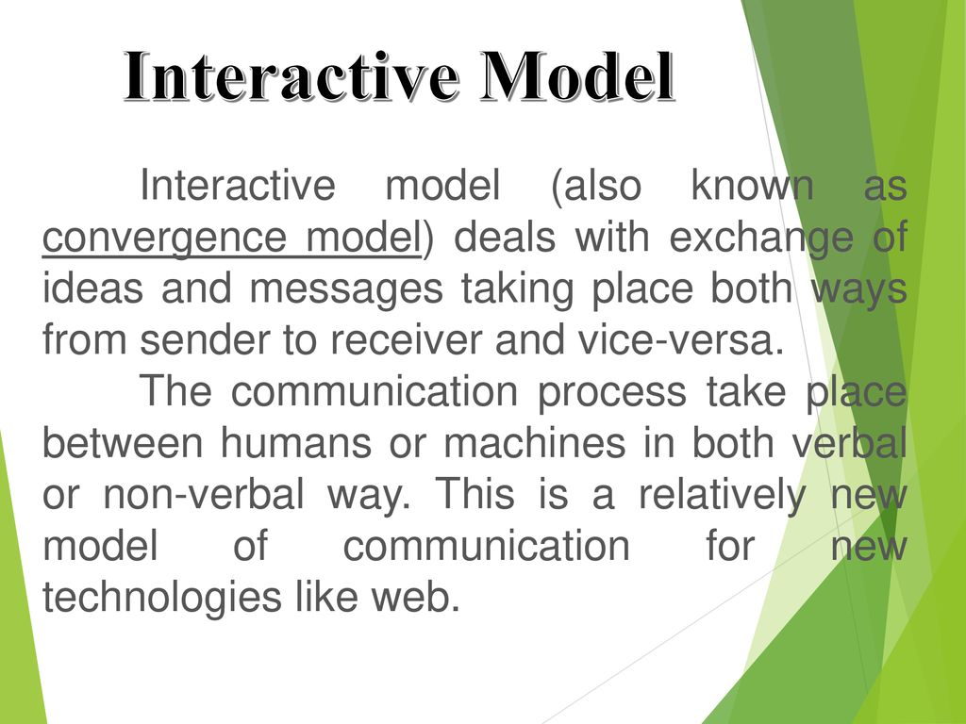

Slide 28
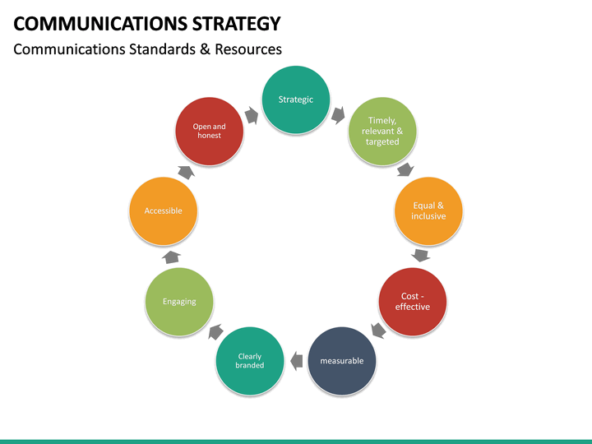

Slide 29
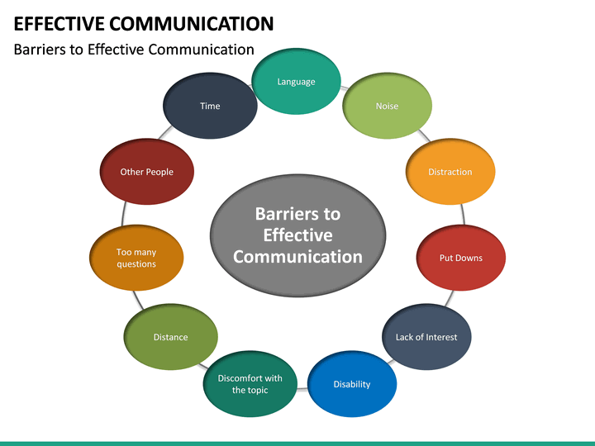

Slide 30
HOW TO MAKE Communication EFFECTIVE
Regulating the flow of communications: Planning communication should involve determining the priority of messages to be communicated so that managers may concentrate on more important messages of high priority. Incoming communication should be edited and condensed, if possible, to reduce the chances of overlooking or ignoring important messages received.
Feedback: Feedback may include the receiver's acceptance and understanding of the message, his action or behavioral response, and the result achieved. Two-way communication is thus considered to be more helpful in establishing mutual understanding than one-way communication.
Language of the message: Use of appropriate language is essential for effective communication, While preparing the message, its sender must keep in view the climate, as well as the ability of receiver to interpret the message accurately. Vague expressions should be avoided. Experimental studies have shown that oral communication accompanied by its written version is more effective in bringing about the desired response.
Importance of listening carefully: Listening to verbal messages carefully implies an active process. A listener has to be patient, mentally composed, and avoid distractions while receiving the message and seek clarification, if necessary. On the other hand, the sender of the message must also be prepared to listen to what the receiver has to say, and respond to his questions, if any.

Slide 31
HOW TO MAKE Communication EFFECTIVE
Restraint over emotion: Strong feelings and emotional stress on the part of either the sender or receiver of messages are serious handicaps in the communication process. To avoid any negative impact of emotion on the content of the message; the sender may defer the communication for sometime or consult to exercise restraint over his, psychological feelings to avoid misinterpreting the message and to be able to respond to it with a composed mind.
Non-verbal signals of compliance: Verbal messages are generally accepted orally by the receiver. But whether action will follow the acceptance of the message is not certain. It is, therefore, suggested that in the case of verbal communication the sender should observe the action of the receiver to ascertain whether the actions are in conformity with the intent and understanding of the message.
Mutual trust and faith: The best means of developing these among people in an organization are honesty of purpose and openness of the managers. Both managers and subordinates have to cooperate for the purpose so that individuals feel free to make suggestions and correct each other's views without misunderstanding.

